Slide 1
Introduction to Devops
At the end of this module, you will be able to
Understand Devops, its roles & necessities
Know about Devops problems and it’s solution
Make a Devops Transition
Learn to identify cultural impediments and overcome it
Understand about building Accountability and Trust
Understand the infrastructure layouts and its challenges
Learn about scalability and availability
Learn about networking concepts from an enterprise perspective

Slide 2
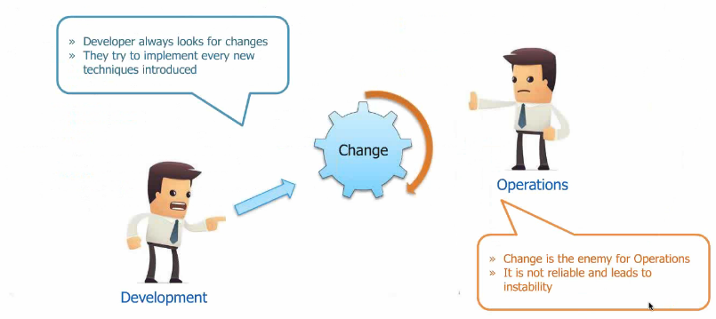
Devops Problem

Slide 3
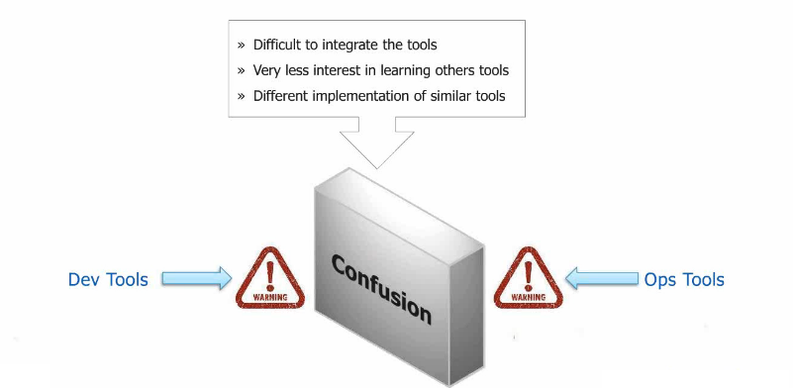
Devops Problem

Slide 4
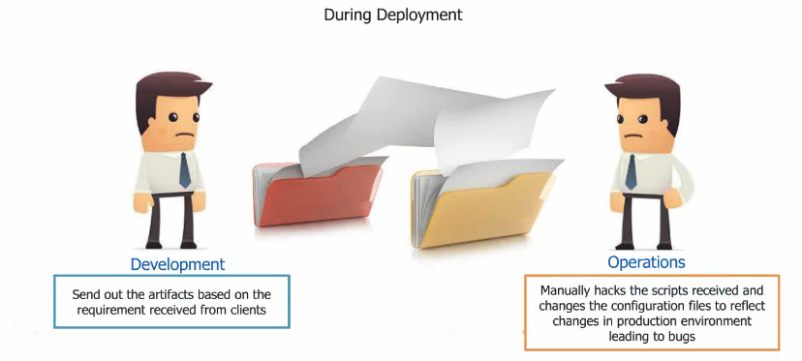
Devops Problem

Slide 5
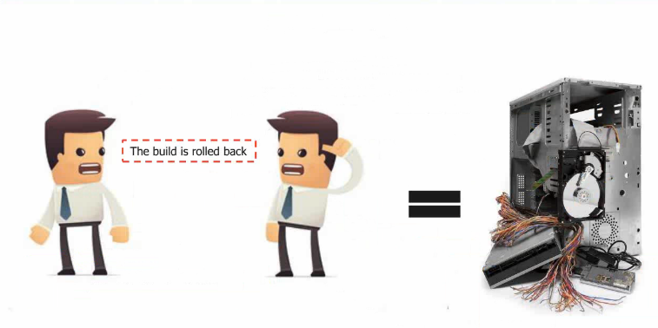
Devops Problem

Slide 6
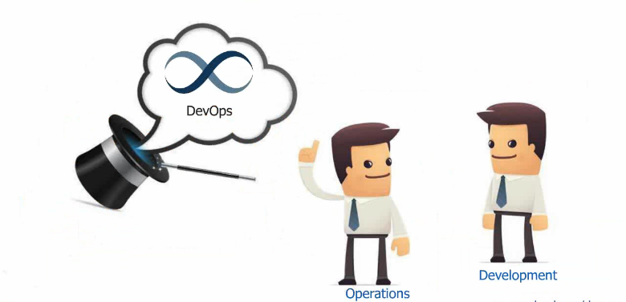
Devops as the Solution

Slide 7
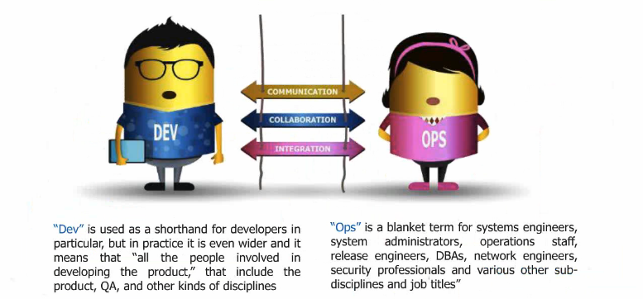
Development & Operations (Devops)

Slide 8
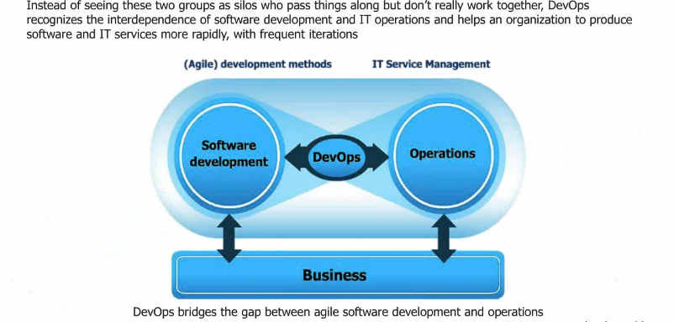
Devops as the Solution

Slide 9
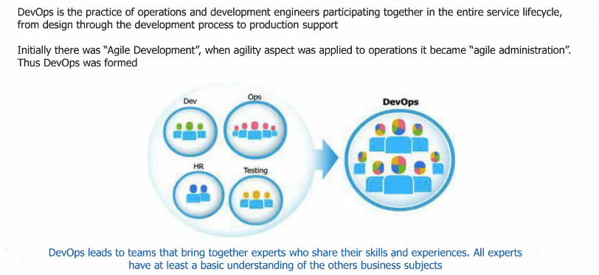
What is Devops

Slide 10
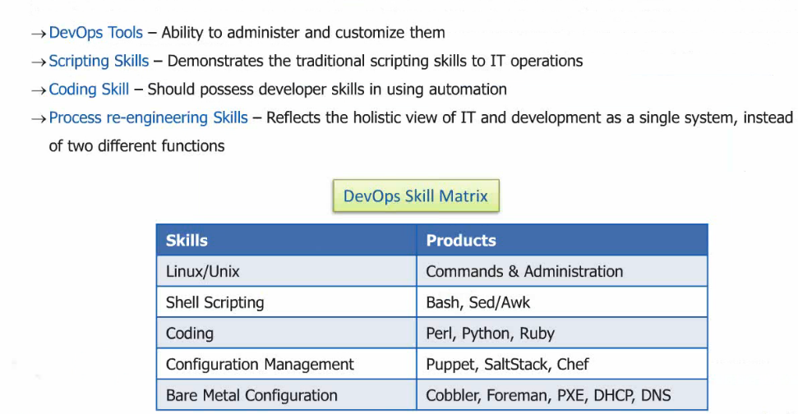
Devops Skills

Slide 11
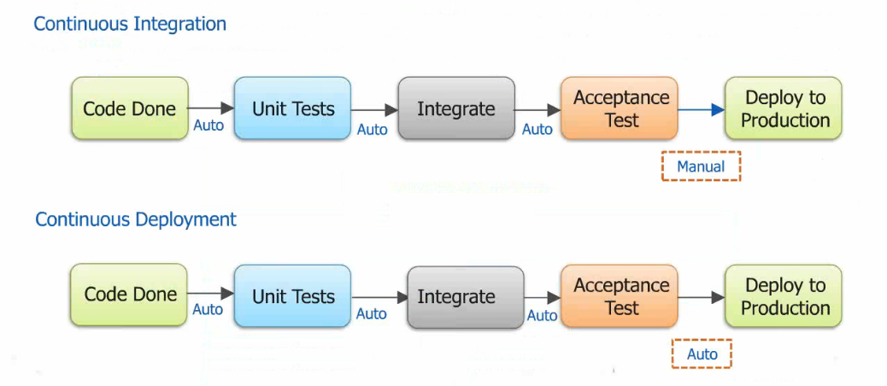
Continuous Integration and Deployment

Slide 12
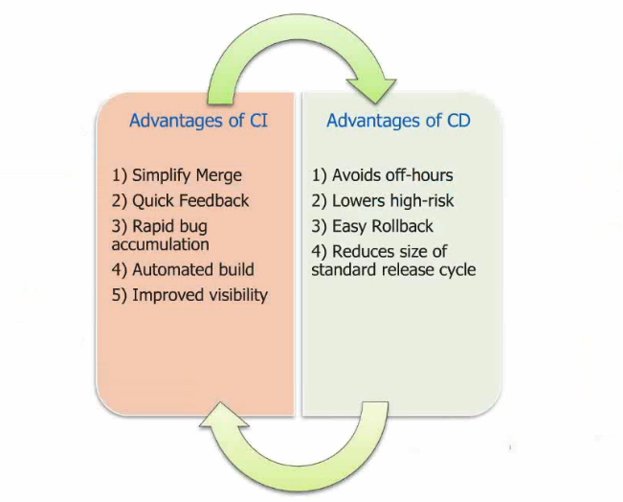
Continuous Integration and Deployment

Slide 13
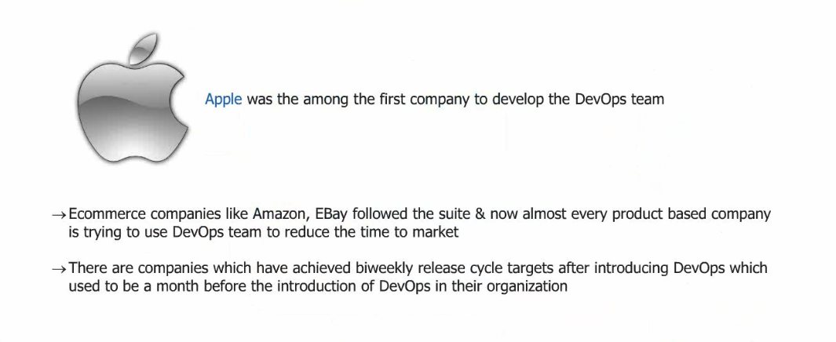
Devops in Real Time

Slide 14
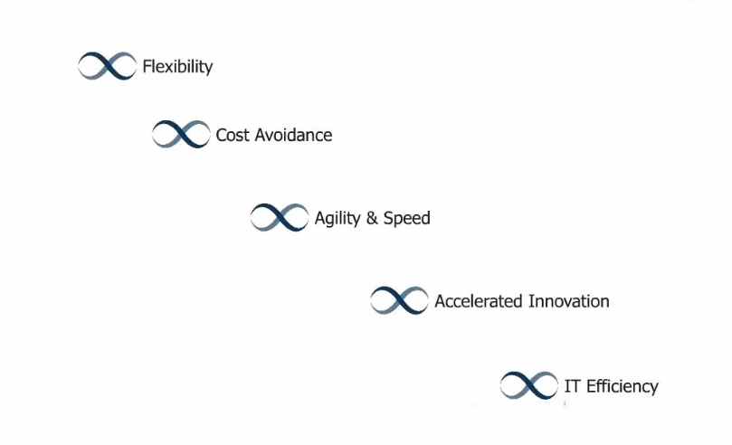
Benefits of Devops

Slide 15
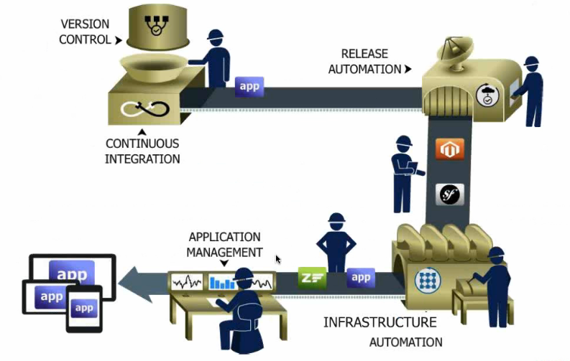
Devops Cycle

Slide 16
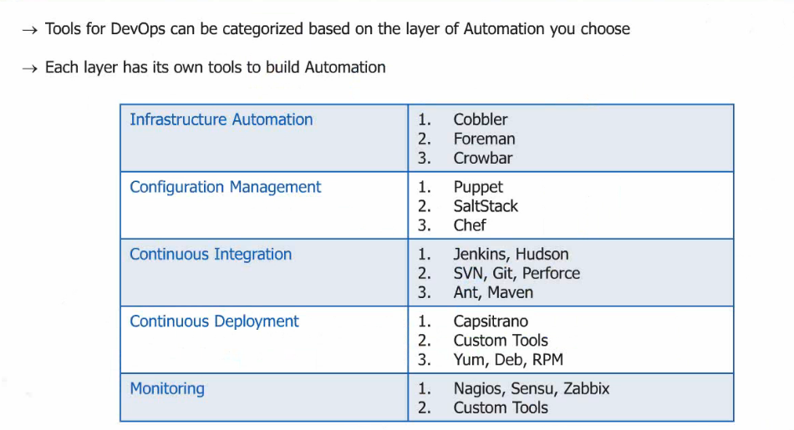
Devops Tools

Slide 17
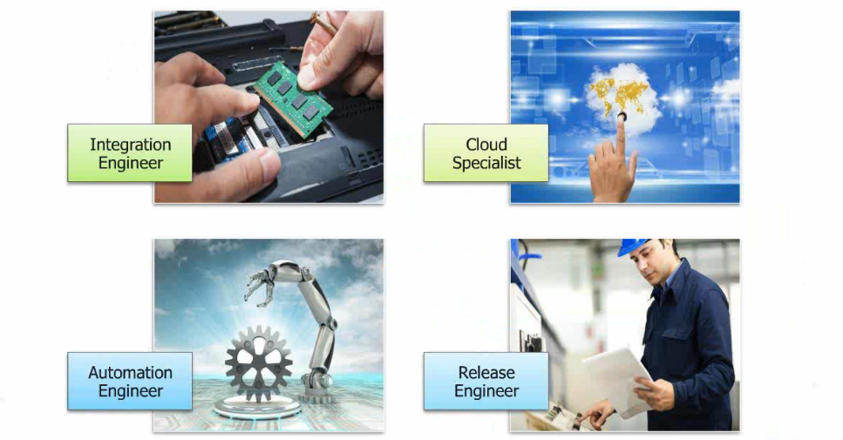
Devops Roles

Slide 18
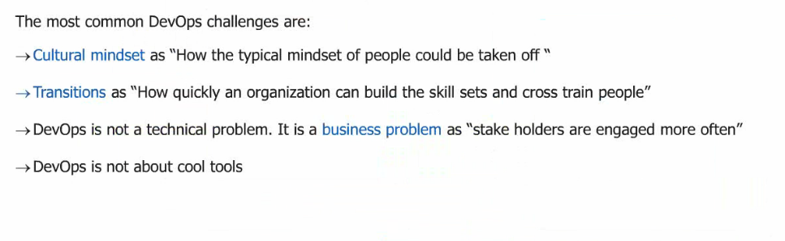
Other Devops Challenges

Slide 19
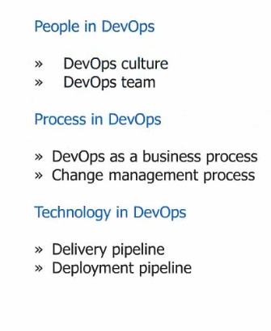
How to Adopt Devops

Slide 20
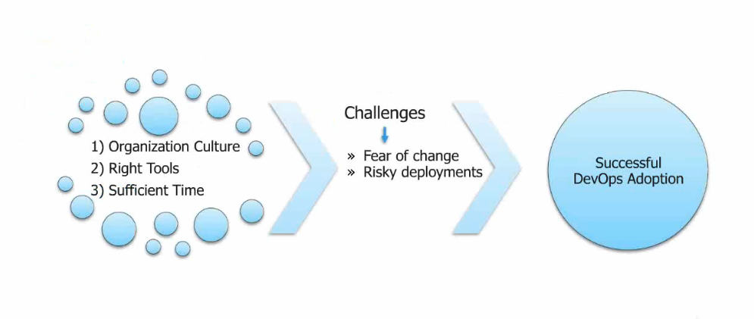
Making a Devops Transition

Slide 21
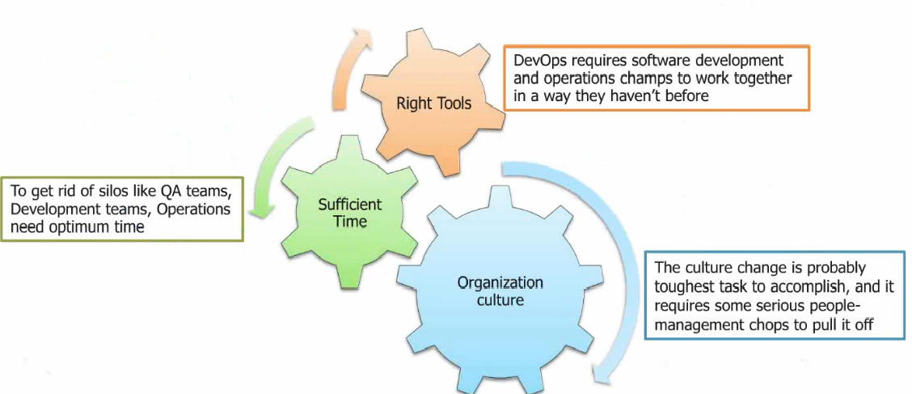
Making a Devops Transition

Slide 22
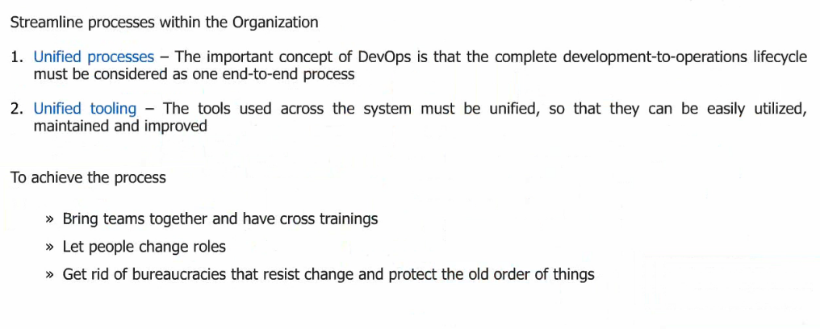
Making a Devops Transition

Slide 23
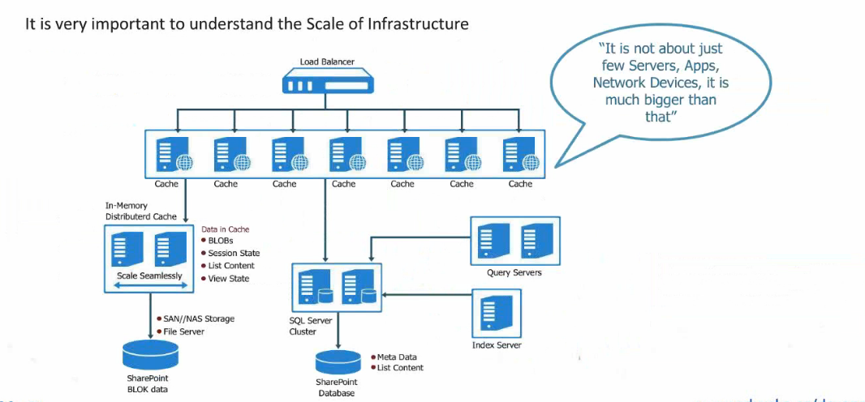
Understanding Infrastructure Layout

Slide 24
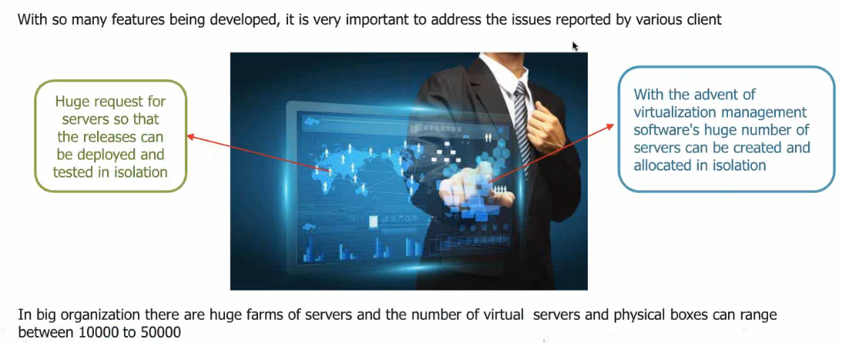
Virtualization

Slide 25
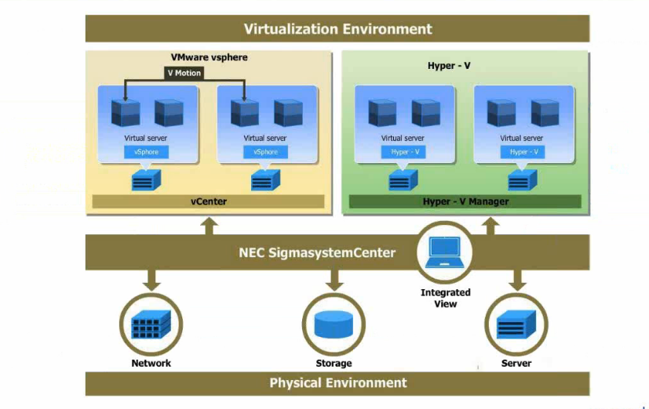
Virtualization

Slide 26
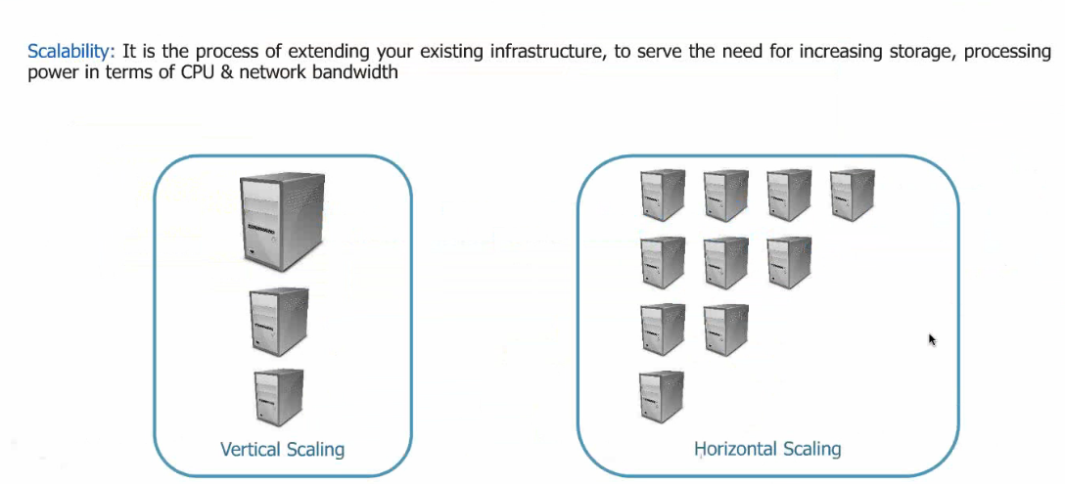
Scalability & Availability

Slide 27
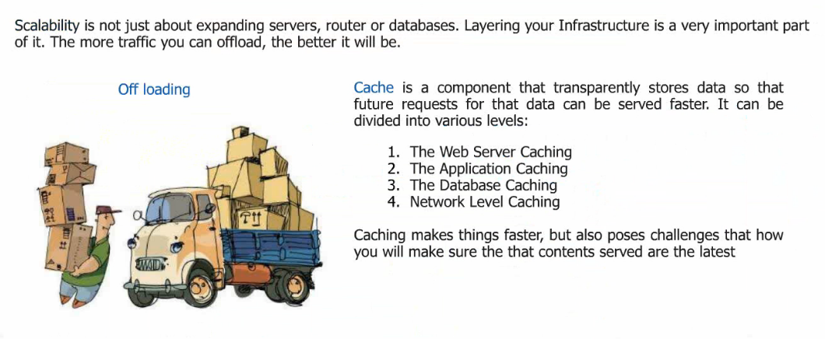
Scalability & Availability

Slide 28
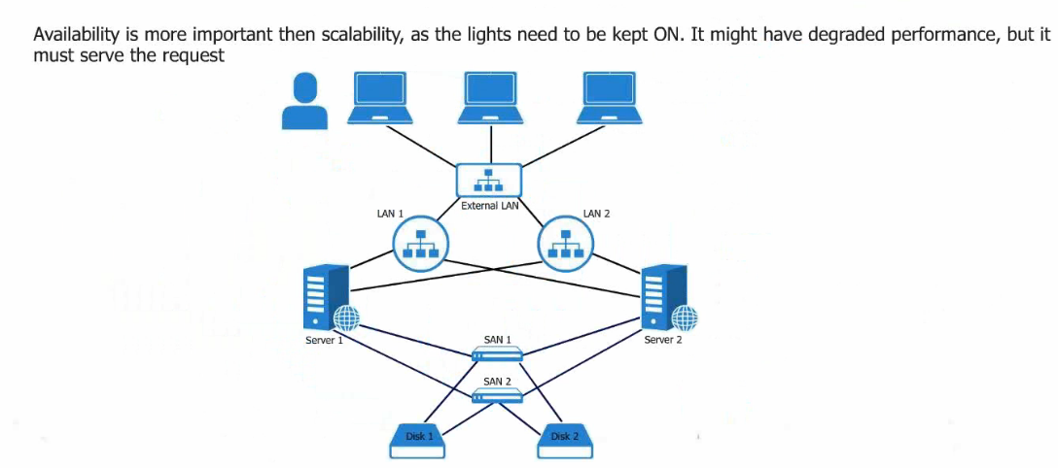
Scalability & Availability

Slide 29
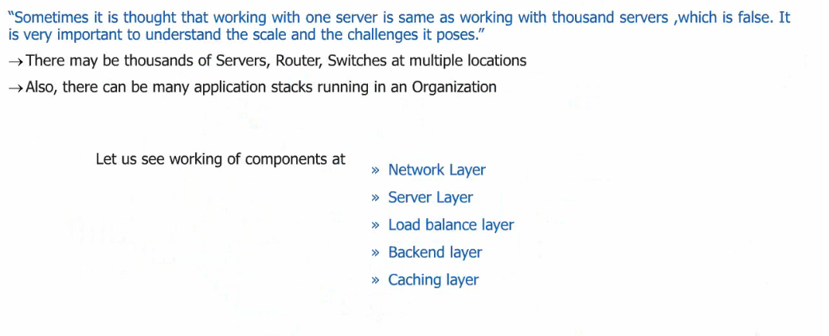
Understanding the Scale of Things

Slide 30
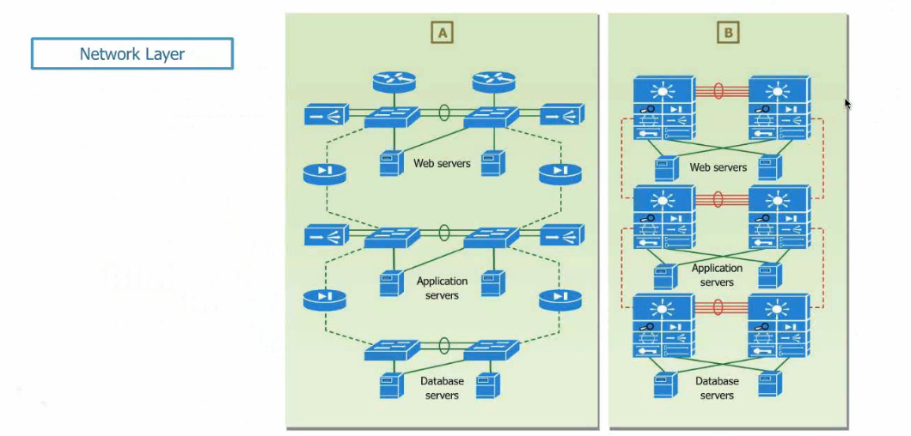
Understanding the Scale of Things

Slide 31
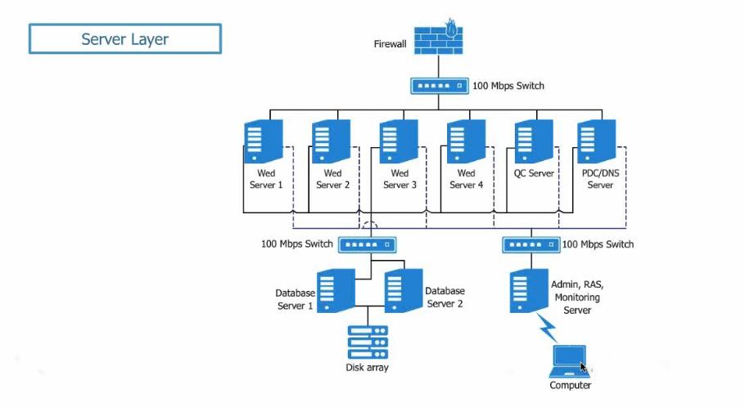
Understanding the Scale of Things

Slide 32
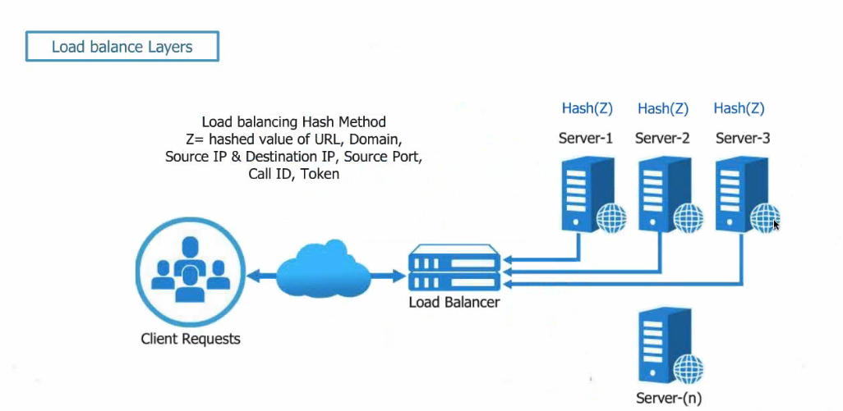
Understanding the Scale of Things

Slide 33
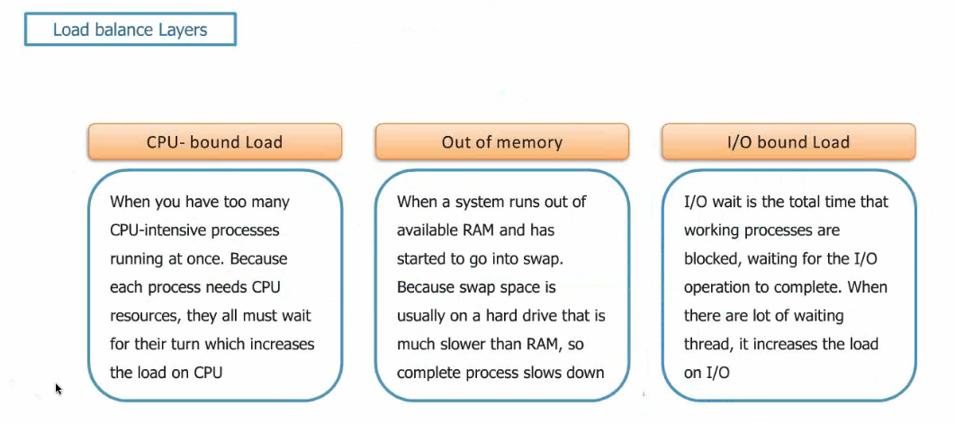
Understanding the Scale of Things

Slide 35
